Slide 1

More than Just Memes and Dreams:
How the Internet Works
Mitch Schmidt

Slide 2
What are we talking about?
History Lesson
Basic Networking
WiFi Background
Sniffing
Scanning
Man In The Middle

Slide 3

How the Internet Came to Be
Invented in 1999 by Al Gore

Slide 4
How the Internet Came to Be
Had early roots in the ARPANET, which had many decisions which would join the internet
First nationwide network that implented TCP/IP (the most common networking implementation)

Slide 5
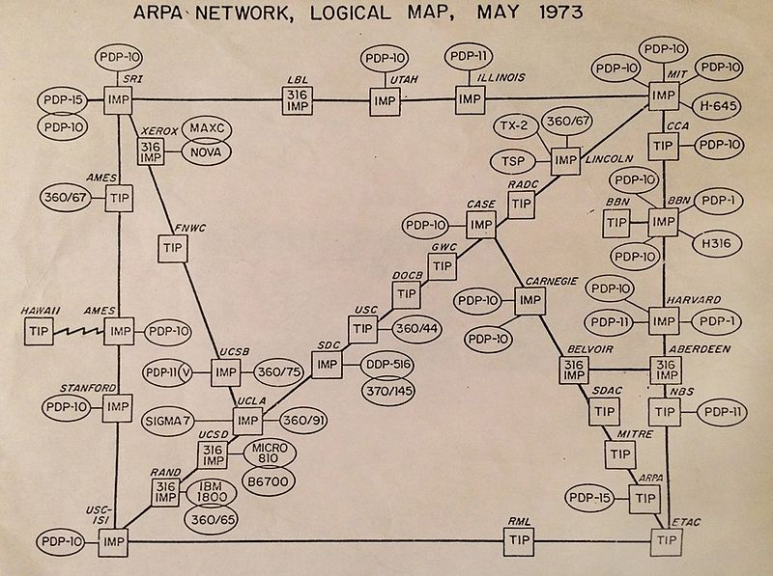

Slide 6

How do computers talk to each other?

Slide 7
NO!!

Slide 8

How do computers talk to each other?

Slide 9
NO!!

Slide 10
How do Computers talk to each other?
Other than some wireless networks, computers must be physically connected
Computers are joined together by physical wiring
Today, your ISP connects to an IXP, which are all connected with each other
There are about 70 in the US

Slide 11
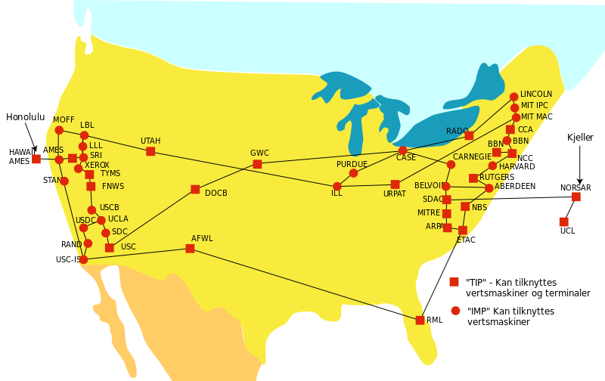

Slide 12
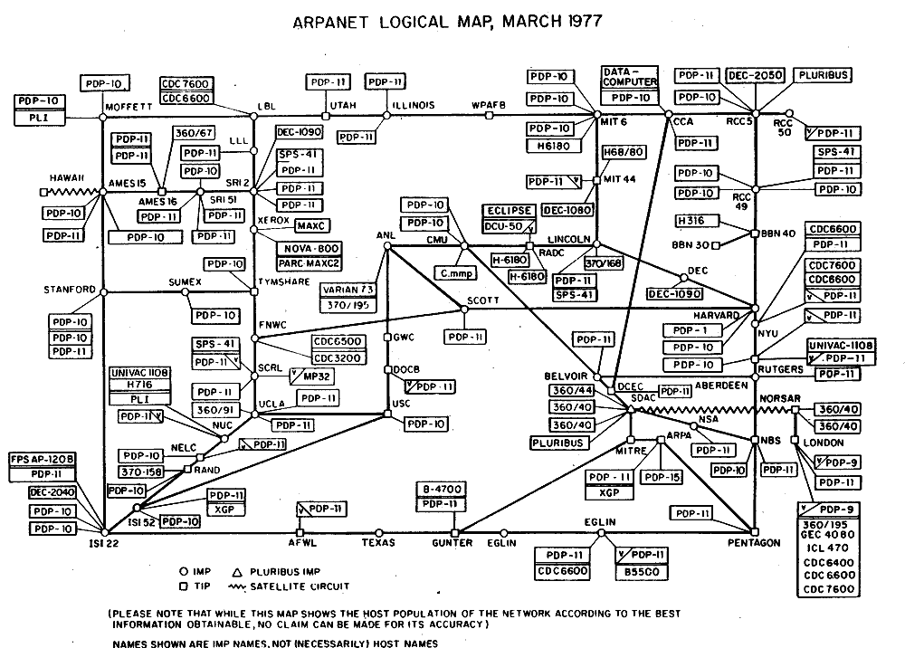

Slide 13
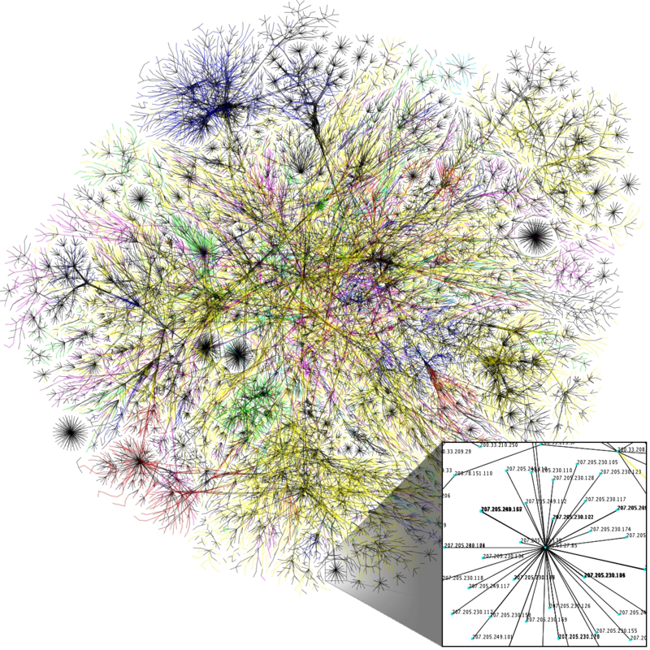

Slide 14
But *how* do computers talk to each other?
Most networking implementations are based on the TCP/IP or OSI model.
This is a networking “stack” that guides logical steps in sending packets from one computer to another

Slide 15
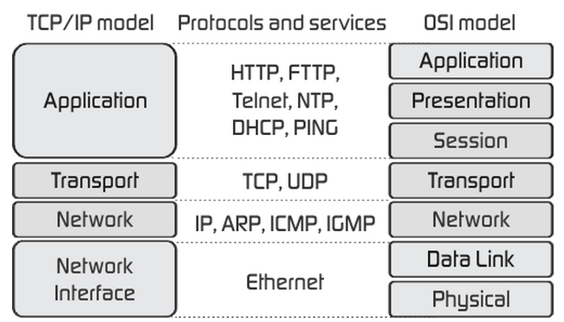
Computer Networks 101
source:
http://fiberbit.com.tw/tcpip-model-vs-osi-model/

Slide 16
Ethernet
Media Access Control
Physical Medium
Relatively Short Connections
Protocols assume MAC address will be relatively stable

Slide 17
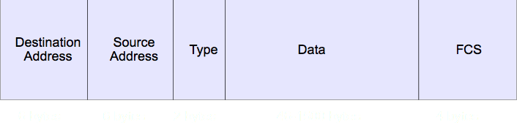
Ethernet Frame

Slide 18
IP
Basic routing of the internet
Method to deliver packets from source to destination
IPv4 and IPv6 addresses
How many IP addresses can a computer have?

Slide 19
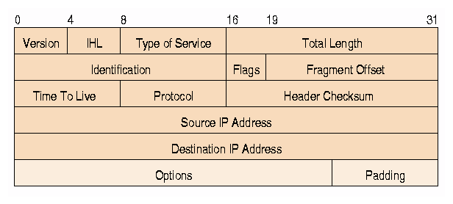
IP Packet Header
source: http://www.freesoft.org/CIE/RFC/791/iphdr.gif

Slide 20
IP and Ethernet
Address Resolution Protocol connects IP addresses with physical, MAC addresses

Slide 21
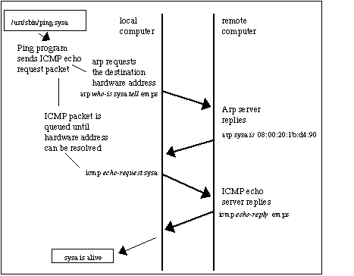
Source: http://www.erg.abdn.ac.uk/users/gorry/course/inet-pages/arp.html

Slide 22
ARP Cache Poisoning:
The Ol’ Switcheroo
2 Victims, A and B
Tell Victim A you are B
Tell Victim B you are A
Nothing in the ARP Protocol prevents this

Slide 23
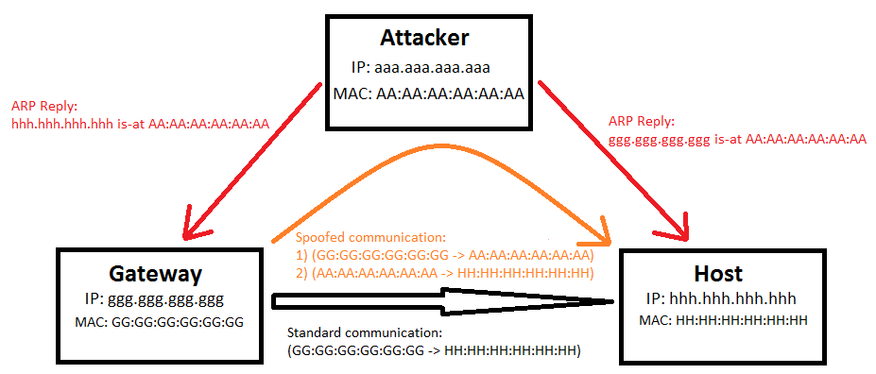
ARP Cache Poisoning
Source: http://icanhazsecurity.ondrejdavid.com/2013/05/pentesting101-7-sniffing-in-switched.html

Slide 24
TCP
Transmission Control Protocol
Negotiate Conversations Between two IP Addresses
Specific protocol for sending data
Synchronous

Slide 25
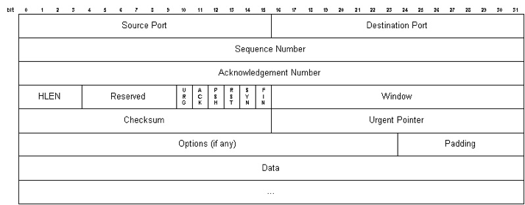
TCP Header

Slide 26
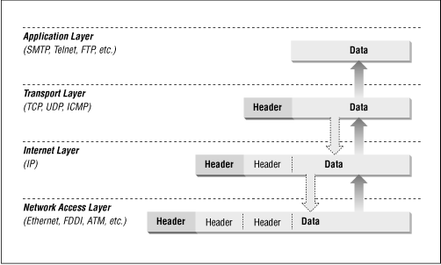
Putting It All Together
Source: http://www.diablotin.com/librairie/networking/firewall/figs/fire0602.gif

Slide 27
UDP
Unified Datagram Protocol
Fast, connectionless alternative to TCP
Doesn’t synchronize
No guarantee packets will be received [in order]
Either TCP vs UDP or how DNS works will be asked in every Cybersec interview

Slide 28
WiFi
802.11
Frame just like Ethernet
once it gets to the router it’s just like other networks
Radios!

Slide 29
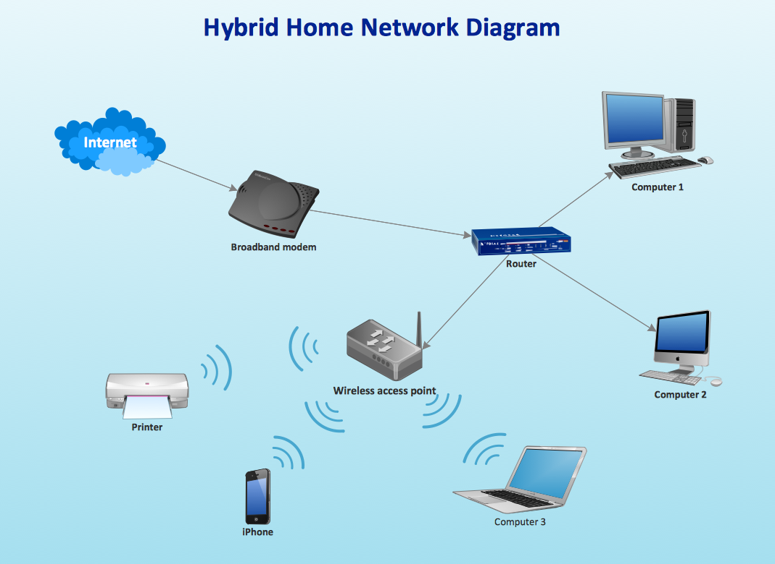
The Network You Know
Source:
http://www.conceptdraw.com/How-To-Guide/picture/Hybrid-ethernet-router-wireless-access-point-network-diagram.png

Slide 30
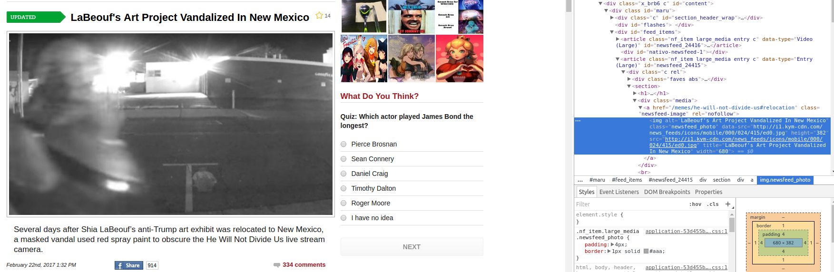
So what happens when you visit a website?

Slide 31
So what happens when you click a link?
http://i1.kym-cdn.com/news_feeds/icons/mobile/000/024/415/ed0.jpg is the name of the site I’m trying to access, but how does that work?
http://i1.kym-cdn.com doesn’t mean anything to my computer
For this problem we have Domain Name Servers

Slide 32
DNS
Used to resolve hostnames to IP addresses
Your computer asks a DNS server what the address is for your hostname
Either it is in the cache and it returns the IP address, or it asks the “Root Nameserver” where the tld is
The tld knows where it’s domains are and directs you to the domain nameserver

Slide 33
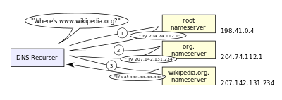
Source: https://en.wikipedia.org/wiki/Domain_Name_System#/media/File:An_example_of_theoretical_DNS_recursion.svg

Slide 34
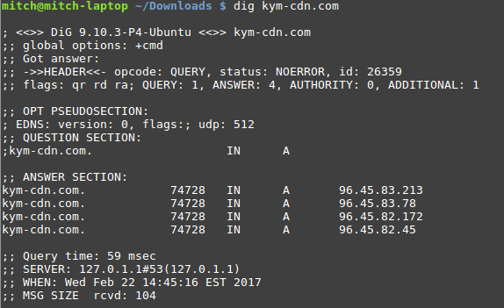
DNS
Use the dig or host tool in linux to resolve hostnames to IP addresses

Slide 35
IP Protocol
Now that we have an IP address, we can send packets from our IP address to another on the internet
Because most computers aren’t directly connected, we have to find a path from one IP address to another
Packets “hop” from one router to another on the internet until they find their destination

Slide 36
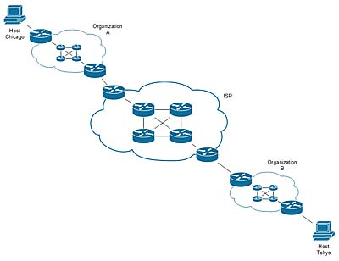
IP Routing
Image shows a path from one host to another via intermediate routers

Slide 37
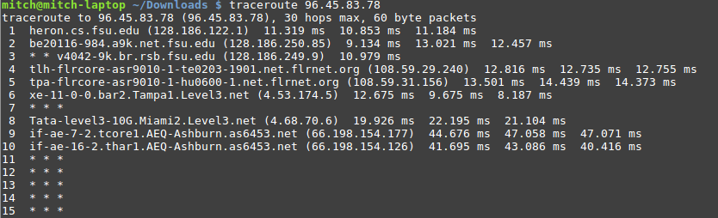
IP routing - traceroute command
Can use the traceroute command in Linux to view the path between hosts
Uses ICMP packets which are often blocked

Slide 38
HTTP protocol
Protocol used to get webpages from hosts
Different methods: GET, POST, HEAD, PUT…
Each do something different, but GET and/or POST will allow you to access a webpage
Different attributes give information to the hosts (cookie, referer, etc)

Slide 39
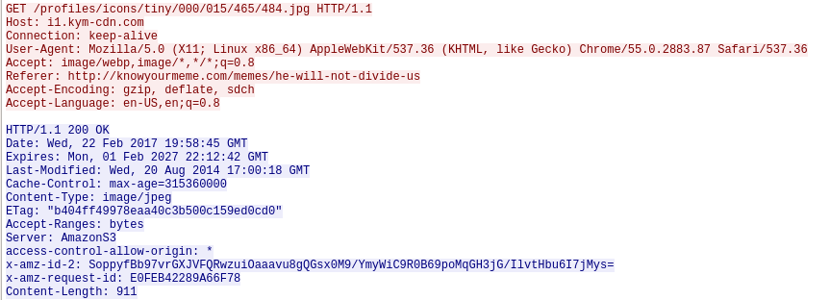
HTTP Request and Reply

Slide 40
But everyone can see your data!
TCP and IP don’t support automatic encryption
So what’s the solution?

Slide 41

Jackie Chan!

Slide 42
NO!!

Slide 43
TLS and SSL
Transport Layer Security and Secure Sockets Layer
Used to encrypt TCP traffic
Public Key Cryptography
Requires both client and server to run compatible crypto suites (and to be running it period)

Slide 44
Encryption!
Works by forming keys with your data, then placing that into another data-shaped lock
Examples:

Slide 45


Slide 46


Slide 47


Slide 48


Slide 49
Encryption
But actually…
Use someone else’s ‘public key’ to encrypt data to send to them
Use your own ‘private key’ to decrypt data sent to them

Slide 50
Let’s review
Resolve hostname -> IP address
Send packet to that IP address
Use TCP to send the packet
Use the HTTP protocol to send data
(sometimes) Use SSL or TSL to encrypt data being sent in the TCP packet
Note: We are ignoring Physical and Data Link Layers in this description

Slide 51
Other common protocols
ssh (22) - used to remotely control hosts
telnet (23) - used to remotely control hosts (unencrypted)
[s]ftp (20,21/989/990) - used to transfer files
rdp (3389) - Windows version of ssh
smtp/imap/pop (25/143/110) - email protocols

Slide 52
Protocols
A good way to learn about them is to capture packets on your local machine, then google whatever protocols you find that look interesting

Slide 53
Sniffing
Everything is radio
Not easy to stop sniffing:
Outside the Network: Crypto WEP, WPA2
On The Network: harder
Monitor outside network
Promiscuously on network
Generate PCAP files
Wireshark, Airdump

Slide 54
Sniffing
Listening in monitor mode,
platform dependent
Raw 802.11 traffic
Problem: it is encrypted!
Wireshark decryption
Need SSID:Key pair
WPA need to capture EAPOL handshake
Woot, all your browsing are mine
https://wiki.wireshark.org/HowToDecrypt802.11

Slide 55
Scanning
Detect what services are running and where
nmap
ping scans
tcp scans
Build Out Network Topology
DHCP
Gateway
Nodes
Services

Slide 56
Port Scanning
Find Open Ports
80 http
20 ftp
22 ssh
23 telnet
443 https

Slide 57
Man In The Middle
Arp Cache Poisoning
Read and manipulate all the traffic
DNS Attacks
Steal Data, Replace Data
Ettercap Filters

Slide 58
Protection
VPN VPN VPN
HTTPS for browsing
Make secure connection to proxy
Proxy then makes all network connections for you
TunnelBear example

Slide 59
Metasploit/Armitage
Useful attack platform
Library of exploits, payloads, and shellcode
Meterpreter
Session Manager
Network Operations

Slide 60
Sources:
https://en.wikipedia.org/wiki/ARPANET
http://www.webpagefx.com/data/how-is-the-internet-connected/

